Slide 1
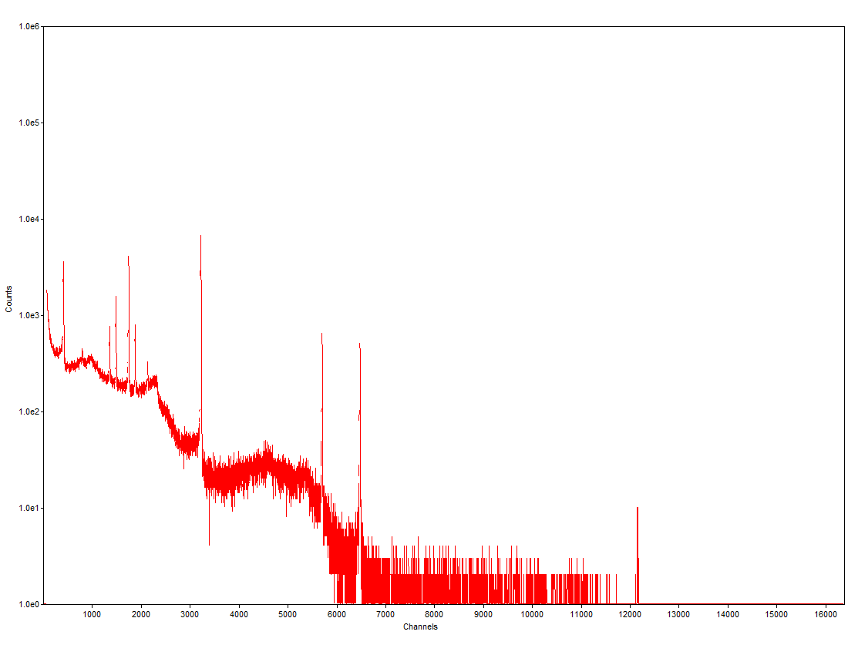

CS 16
Radiation Counting Using Machine Learning
Introduction and background
Acknowledgements
Dr. Steve Reese Director, OSU Radiation Center Capstone Project Client
Ophir Frieder Professor at Georgetown University
Jessica Curtis Recent OSU PhD
Gamma-ray spectrometers record the energy levels of incoming photons from a radioactive sample. Once a spectrum has been recorded by the detector, specialized software is able to analyze it and identify which materials are present by looking for the peaks where a lot of radiation came in at a certain energy level. The detector will gather data on a sample for a predetermined amount of time, commonly a few minutes.
Our project involved using machine learning to predict which materials are present in each sample faster than conventional algorithms. These predictions are made in real time, while the detector is still gathering data.
Applying machine learning to improve detection of radioactive materials
Importance
Fast
Machine learning models can identify materials much faster than humans as well as conventional isotope identification software
Adaptable
Training data can be changed for the application, allowing it to fit a variety of conditions and detectors
Scalable
The data set could be extended to include information from large databases
Samples with many different materials would not add much additional time for calculation while this would be a problem for human analysis
Project members listed from left to right:
Ian Brown; CS Senior
browni@oregonstate.edu
Yihong Liu; CS Senior
liuyih@oregonstate.edu
Sean Gillen; CS Senior
gillens@oregonstate.edu
Figure 1: An example spectrum generated from a radiation detector. Each count represents one gamma-ray photon hitting the detector, and each channel is a different energy level of photon.
Description
Results/Conclusion
Several combinations of materials were placed in a radiation detector. The detector then sampled each of these combinations and created files containing data about these samples. These sample files were used as the training data set for our machine learning models. Three different machine learning classifiers were used in our application.
Our application uses our trained models to make predictions in real time. Once a detector starts writing data to a file, the models repeatedly make predictions until it is confident enough that it has identified the materials in the detector. If it does not become confident enough after a certain amount of time, it stops itself.
Improved isotope identification times at detector in OSU Radiation Center
Using real-time data from detector allows for continuous analysis
Machine learning is a viable method of radiation spectrum analysis

